Slide 1
R: Where the H*ck to Start
satRday DC

Slide 2
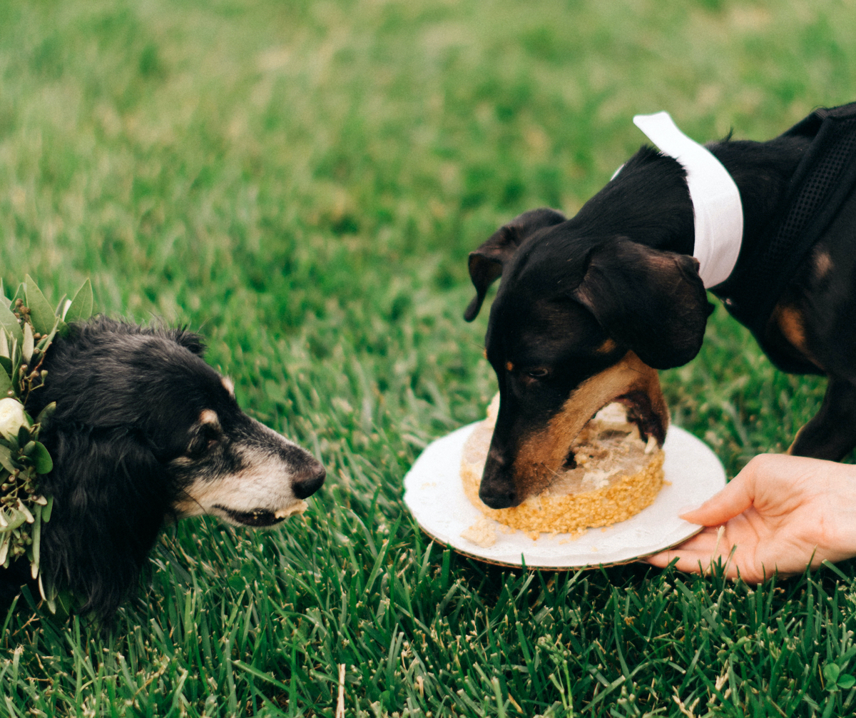
About me
Liberal Arts academic background
Variety of industries before MSDS
Now data analyst & graduate TA
Also really like doggos

Slide 3
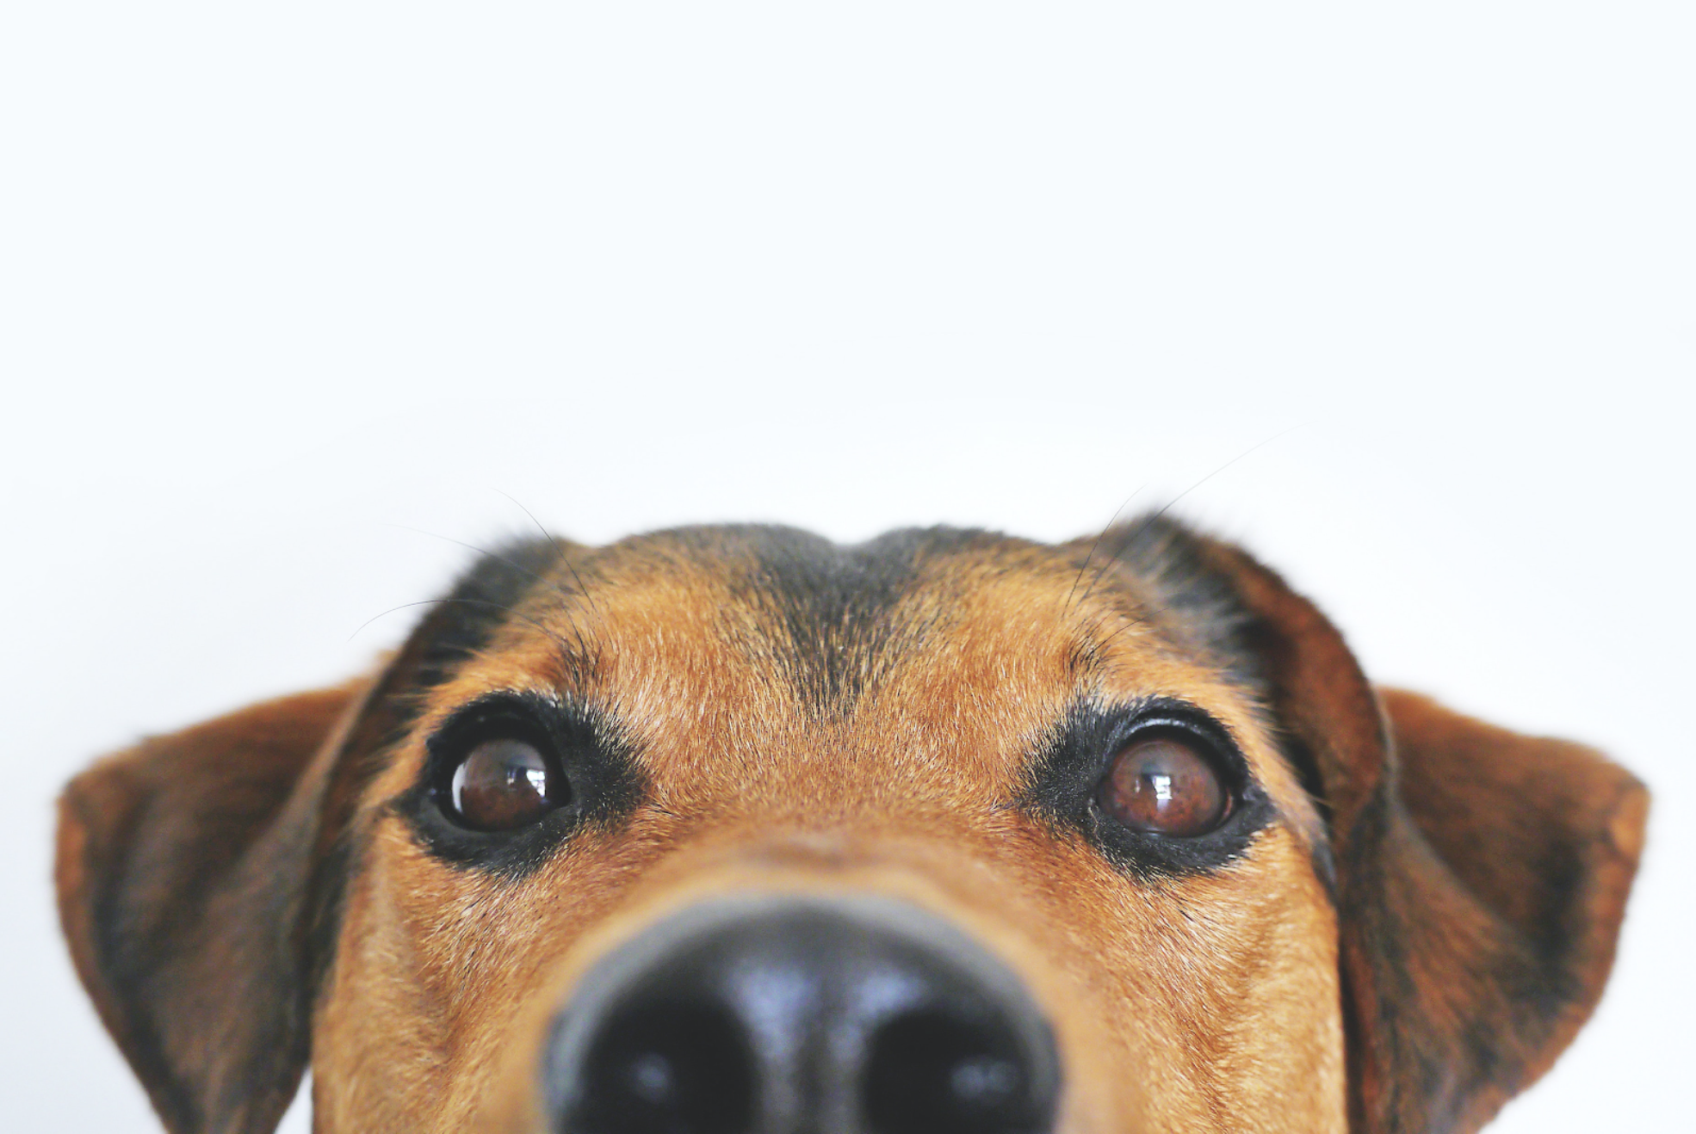
“hi here’s a cute dog pic yay R thank you for coming to my talk byebye”

Slide 4
How I Got Started in R
SPOILER ALERT: 0/10 do not recommend
Enrolled in a data science masters degree with zero programming experience
Began curriculum with two intro-level python courses
Quickly realized I’m in over my head
Came thisclose to quitting
Rallied and managed to complete my first quarter
Switched to R for the remainder of my grad program

Slide 5
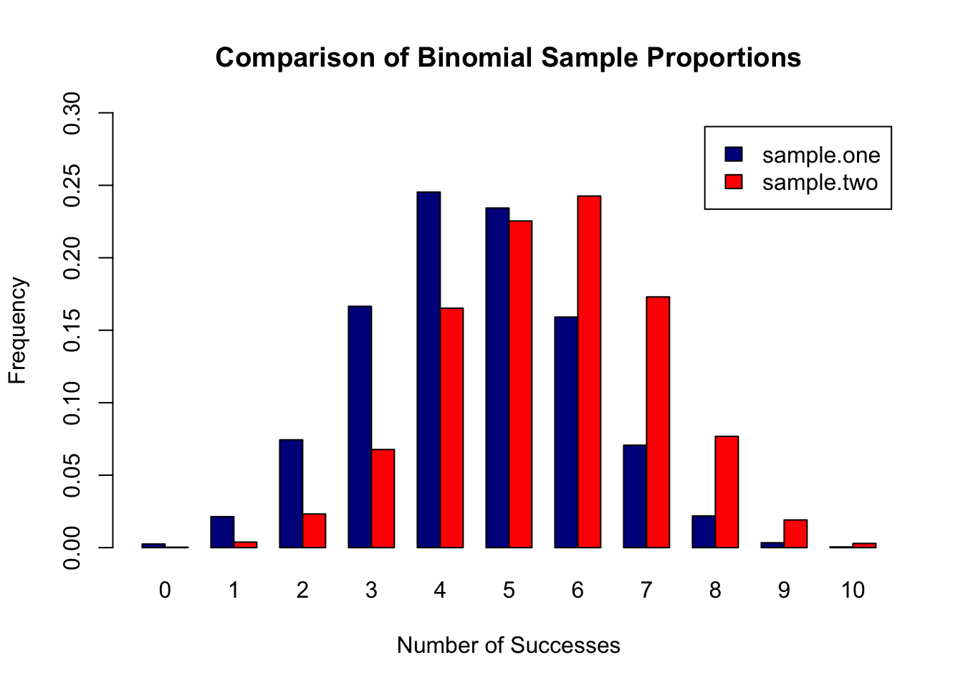
one of my first R things:

Slide 6

How I Got Better in R
Did a bunch of grad school assignments
Googled a LOT of things and wore out cmd+c/cmd+v
Graduated with an MSDS feeling pretty good about my skills
Moved into my company’s data science dept; felt less good about my skills
Worked daily in R for last year+ with support of veteran R users

Slide 7
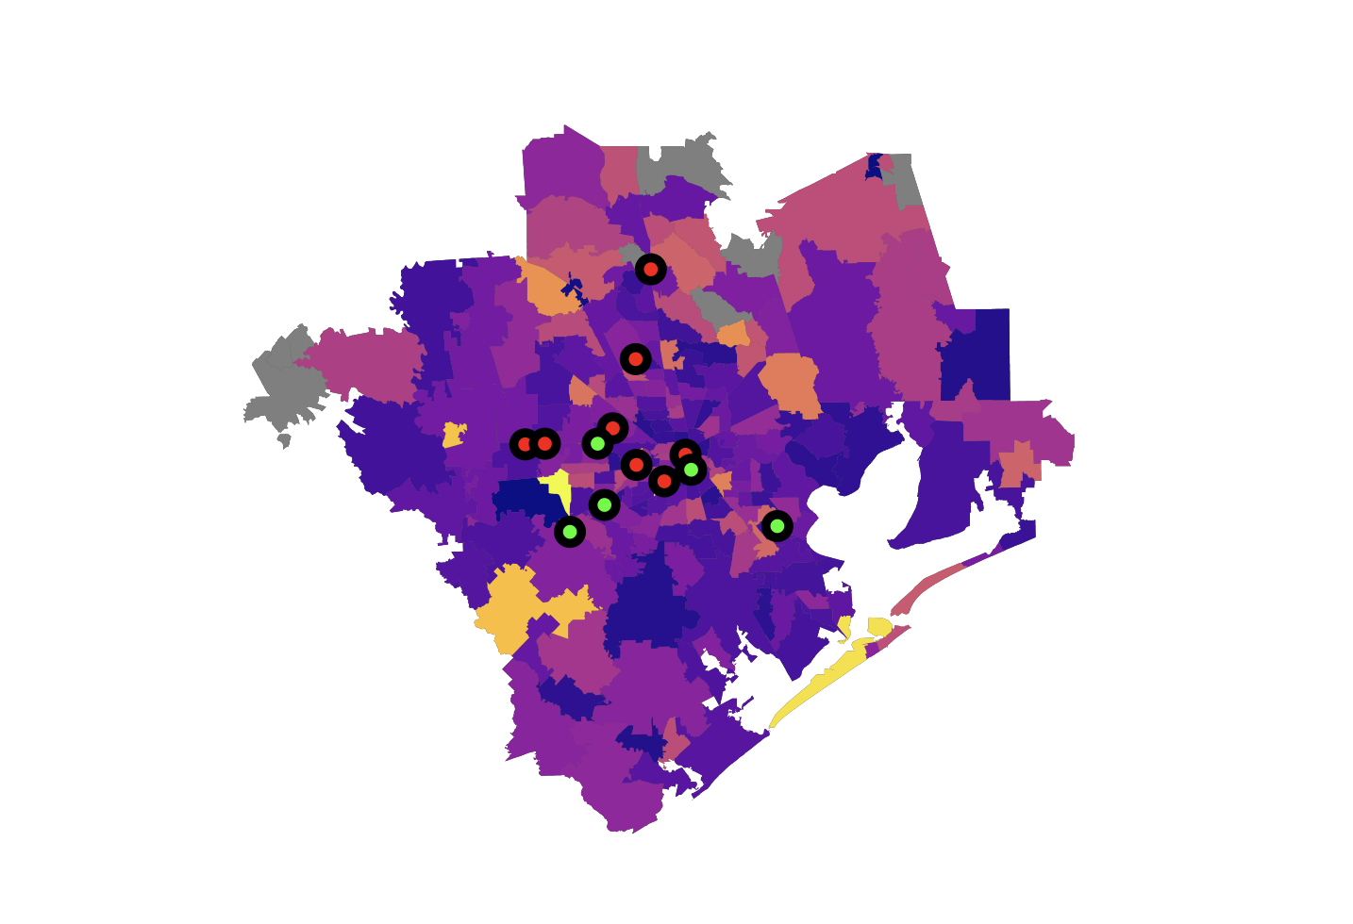
my latest cool R thing!

Slide 8
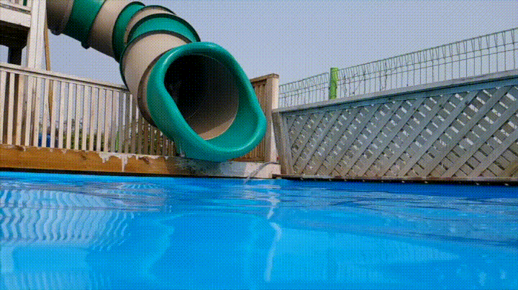
My Best Advice?
Dive in!

Slide 9
First Things First
R (open source programming language)
RStudio (IDE)
Some data
Learning goals

Slide 10
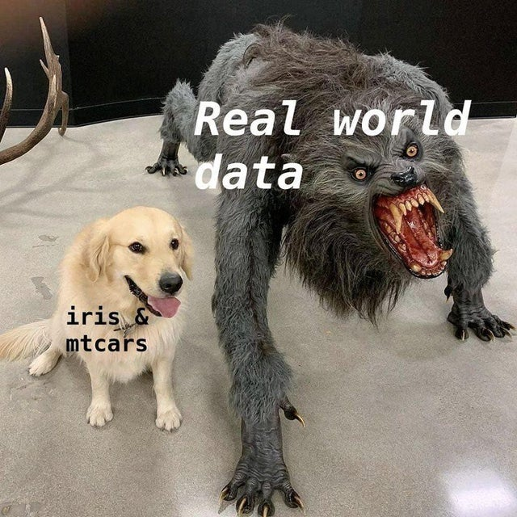
A Warning…

Slide 11
Terms You Should Know
CRAN (Comprehensive R Archive Network)
environment
working directory
project
install.packages(…)
library(…)
?…
browseVignettes(…)
#comment

Slide 12
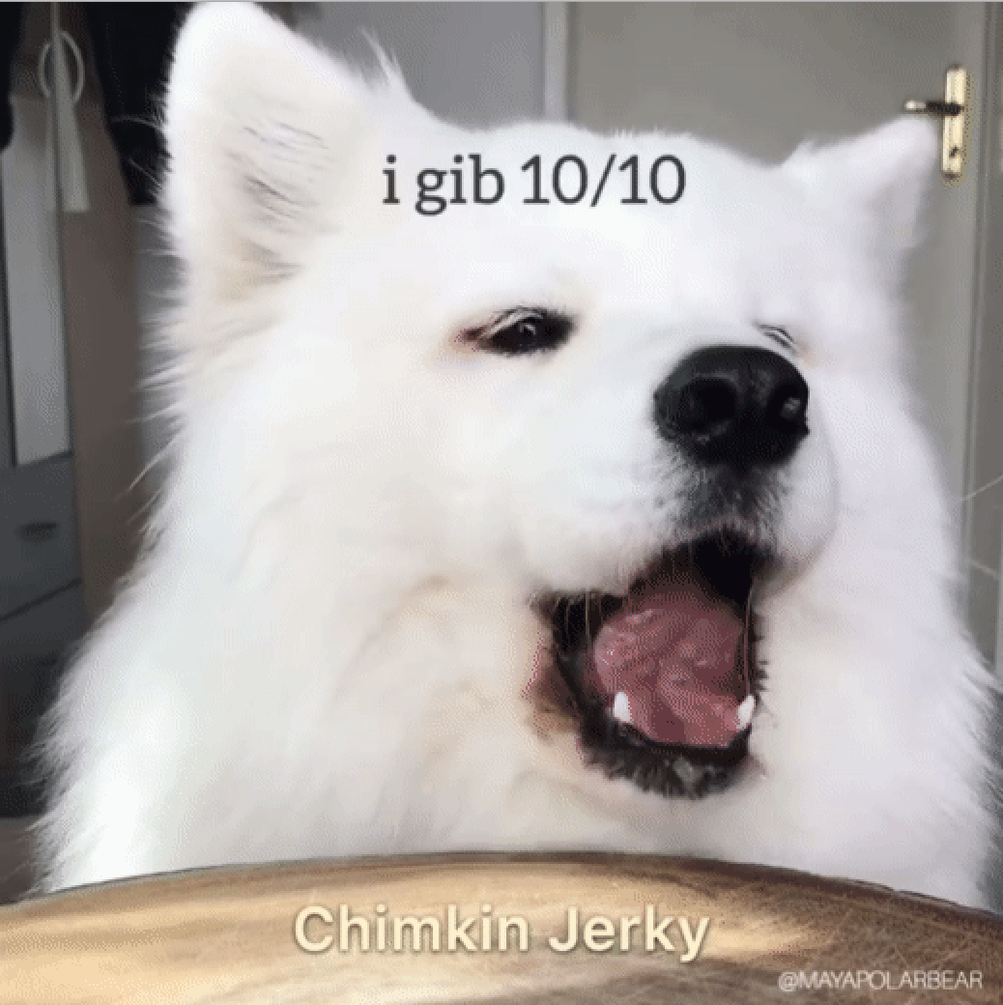
Useful Packages
dplyr
tidyr
ggplot2
lubridate
rmarkdown
shiny

Slide 13
Resources
R Reference Card 2.0
R for Data Science
R Graphics Cookbook
R Markdown: The Definitive Guide
Base R Cheat Sheet
Plus: cheatsheets linked in ‘Packages’ slide

Slide 14
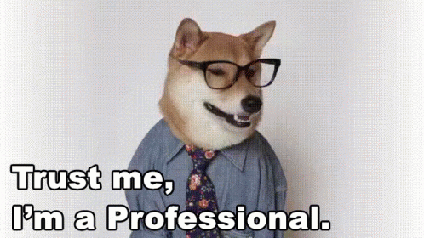
Parting Thoughts
Set small, specific goals so you don’t get overwhelmed
Many, many ways to do the same thing
Use #comments liberally
Remember: even the experts Google for answers… all. the. time.

Slide 15
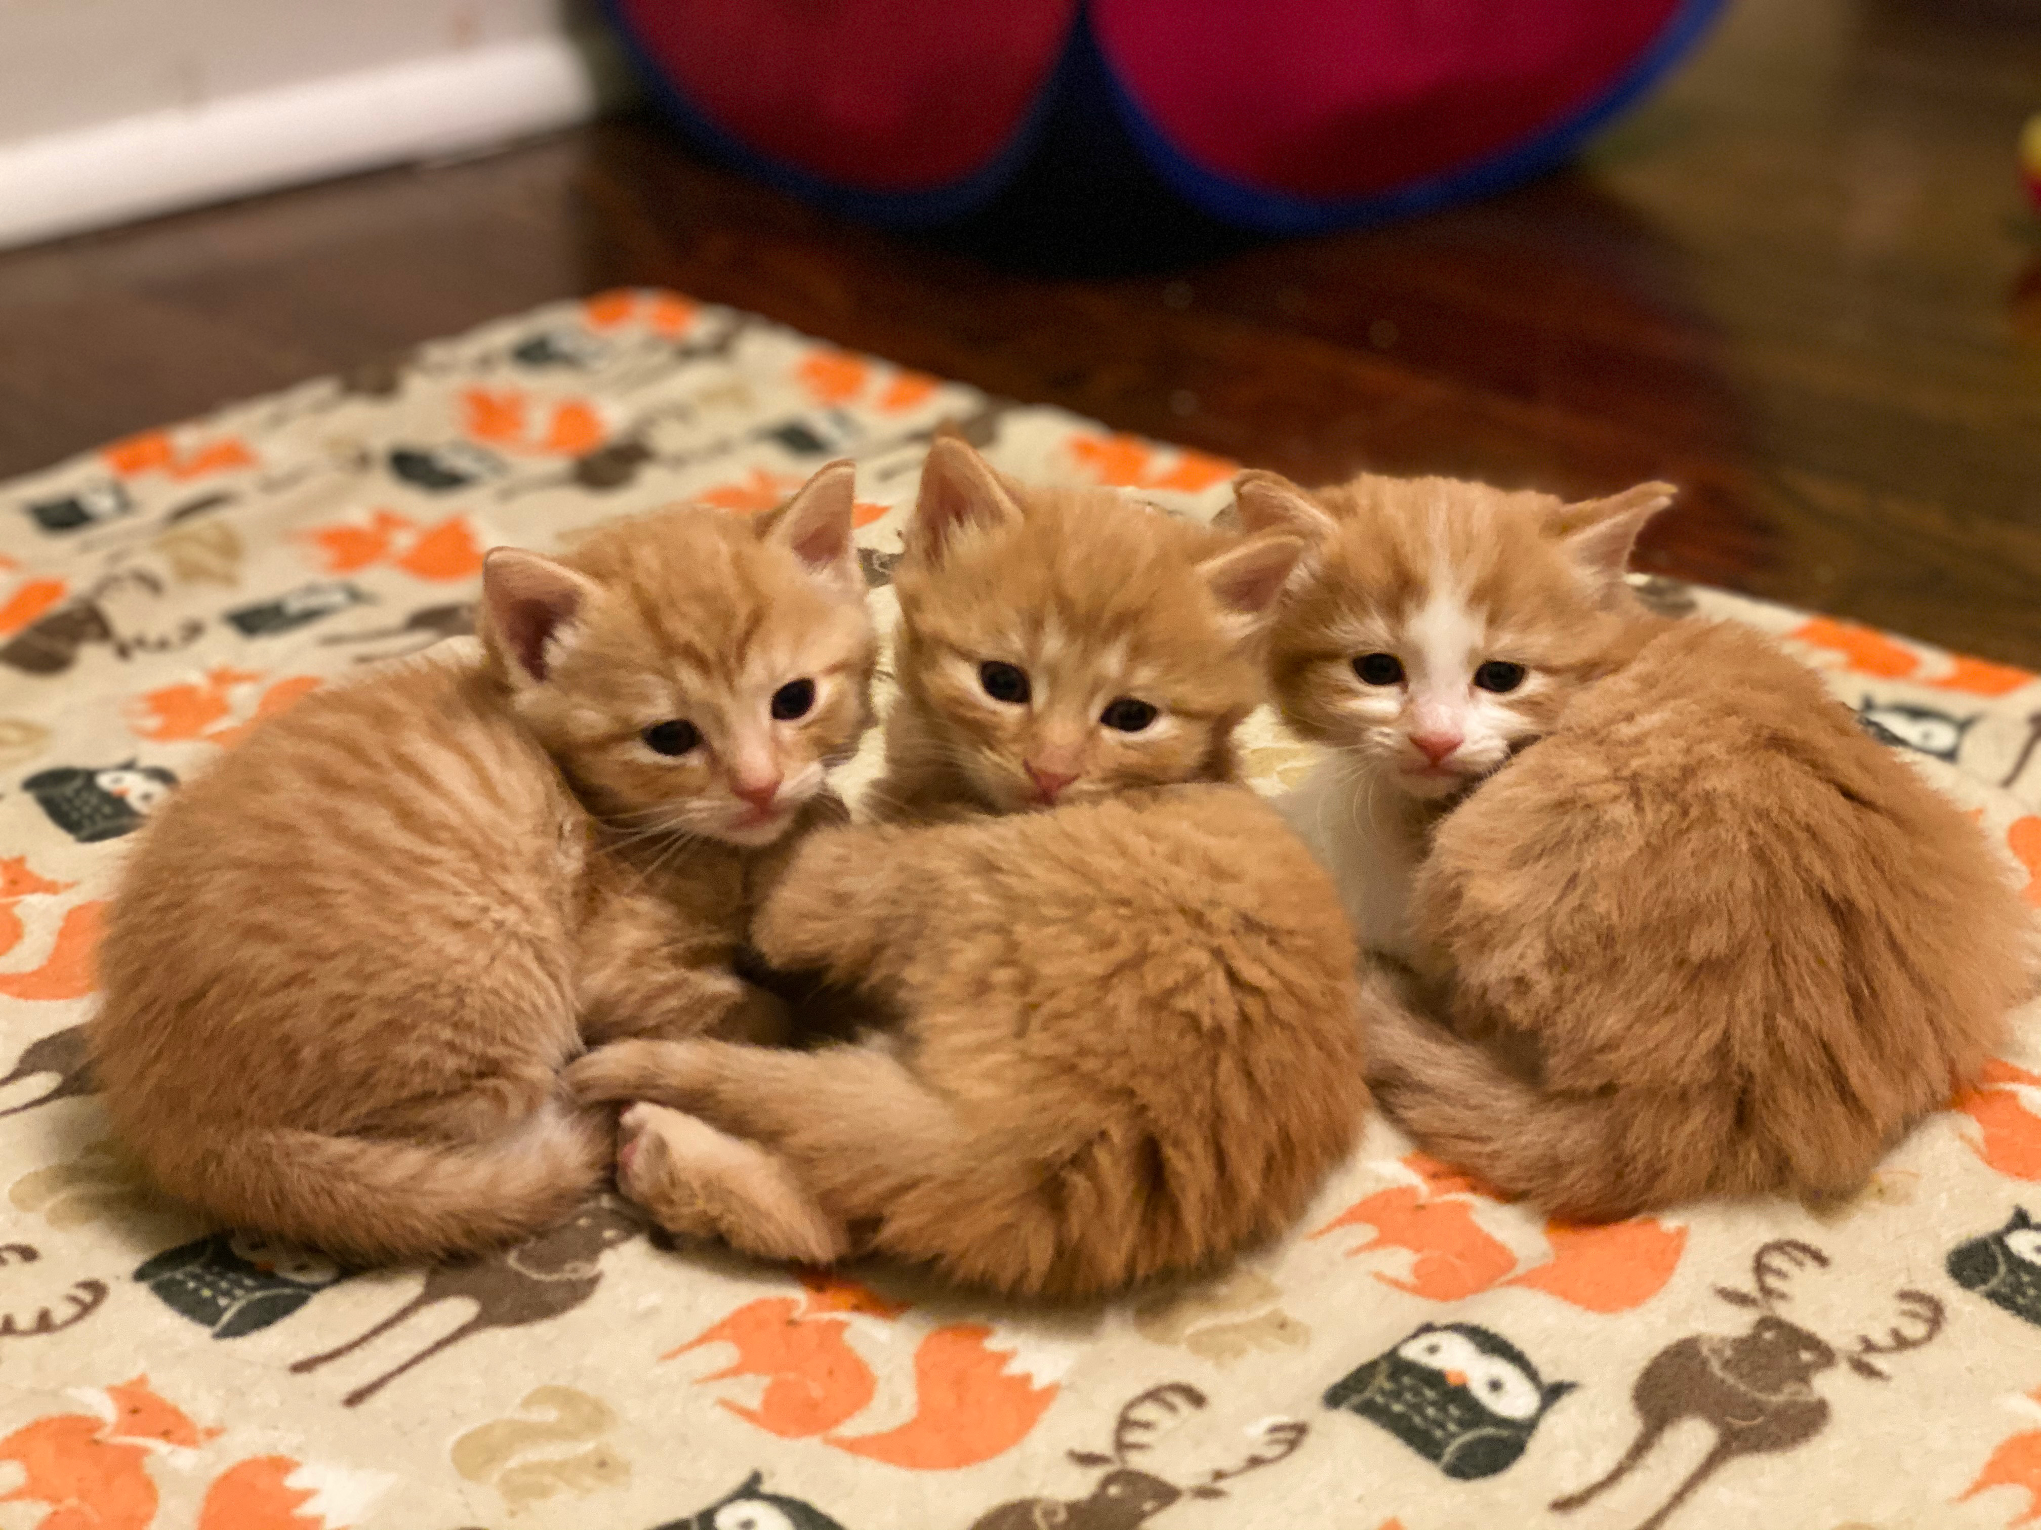
ADOPTABLE KITTEHS!!
(you know need a quarantine friend or two)

Slide 16
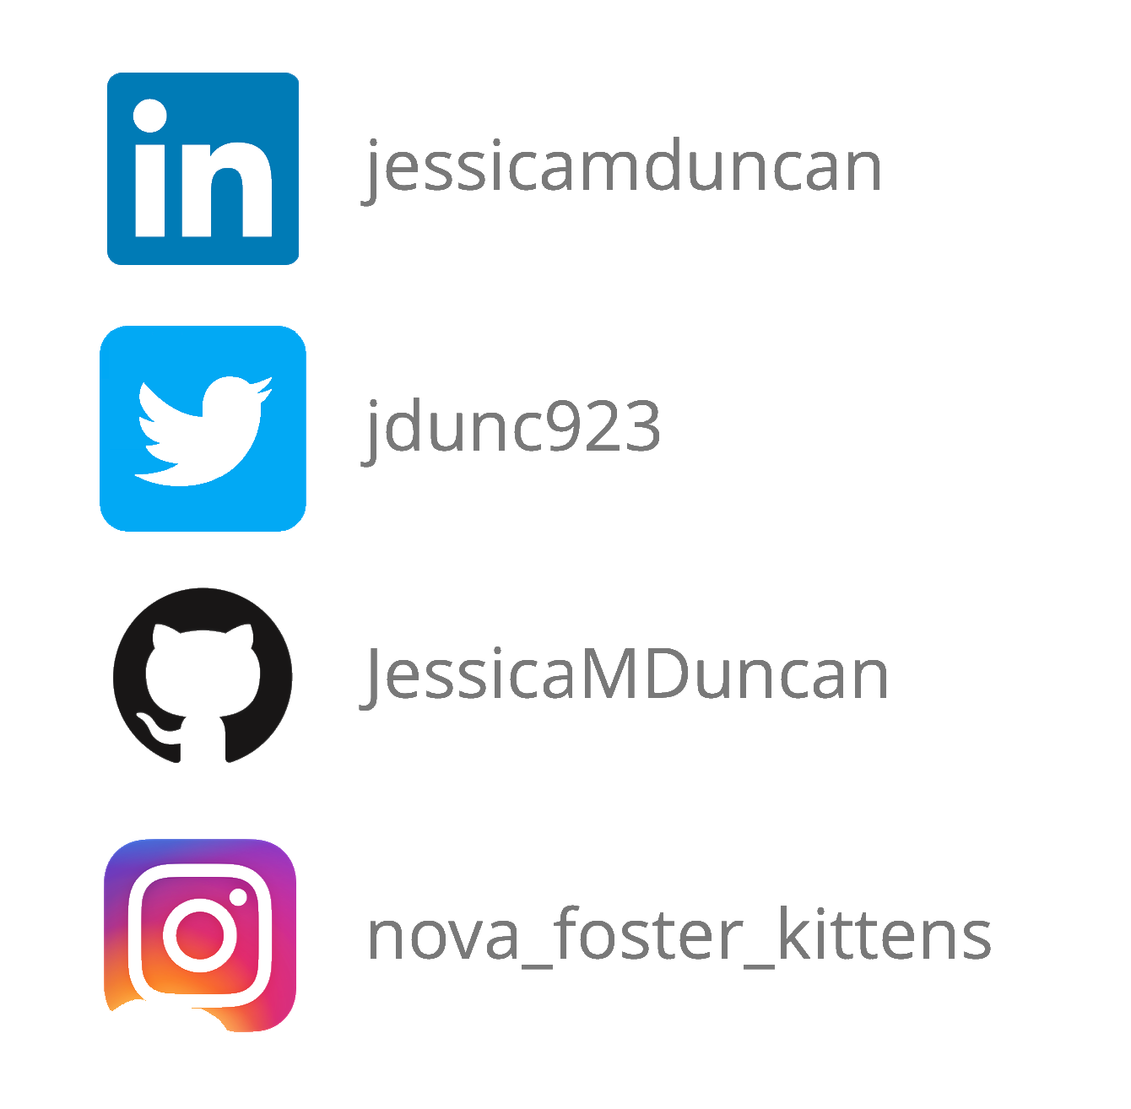
Connect With Me (or Kittens!)

Slide 17
Credits go to…
Close up dog face, slide 3: https://www.pexels.com/photo/adorable-blur-breed-close-up-406014/
‘I have no idea what I’m doing’, slide 6: https://barkpost.com/humor/funny-dog-memes/
Corgi slide gif, slide 8: https://giphy.com/gifs/swim-doing-adorableflop-vfe2WbJh8CW8U/media>
‘Real world data’, slide 10: VooDooEconometrician on Reddit https://www.reddit.com/r/rstatsmemes/comments/cw4axj/trying_to_apply_a_fancy_new_r_library_to_my_real/
‘I gib 10/10’ gif, slide 12: Maya polar bear on YouTube https://www.youtube.com/watch?v=GwkEt_IWZYQ
‘Trust me’ gif, slide 14: https://tenor.com/view/dog-gif-9796017

